Slide 1
Mathematical Methods for Scientific Computing
Numerical Discretisation
Stephen Millmore
Laboratory for Scientific Computing,
University of Cambridge

Slide 2
Outline
1. Discretisation and error
2. Fourier Series (briefly)
3. Interpolation
4. Root finding
5. Runge-Kutta methods

Slide 3
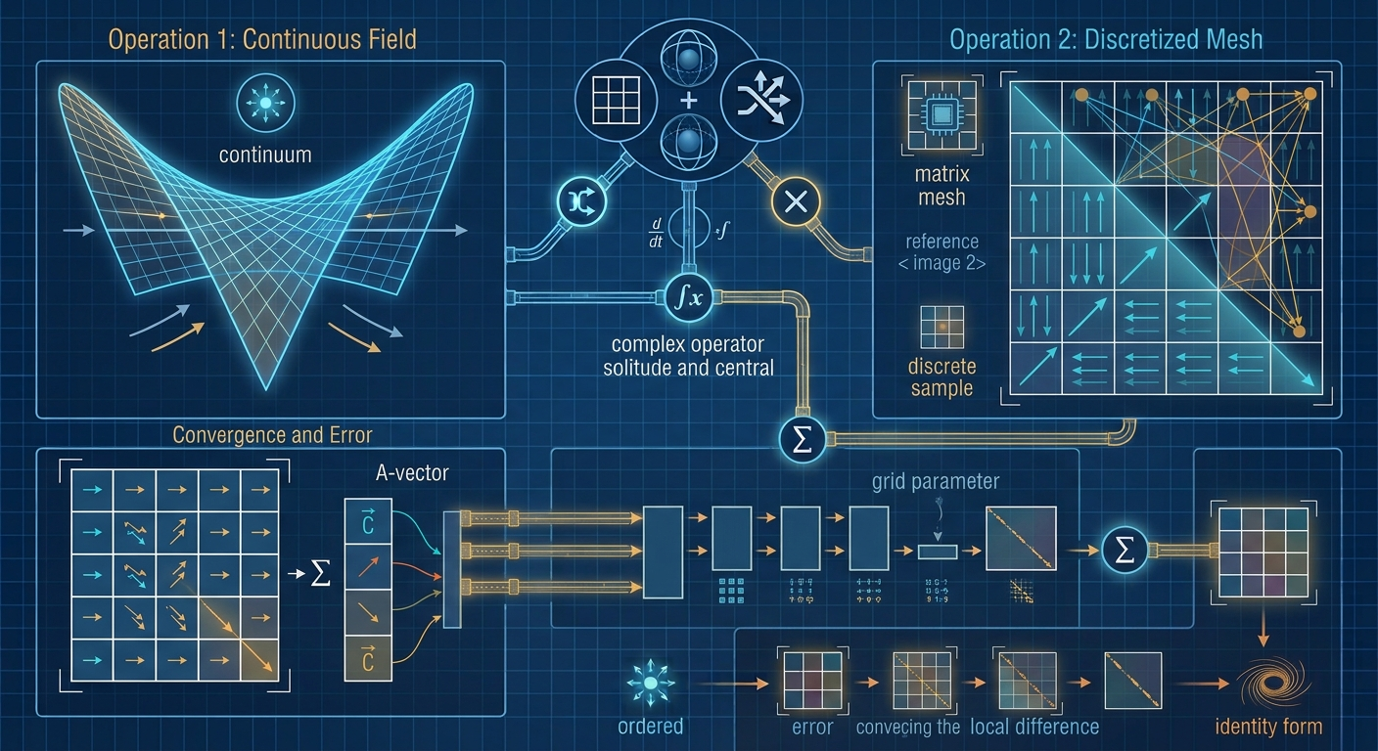
Discretisation and error

Slide 4
Discretisation
All computational simulations require some means of discretisation of a continuum domain into a discrete one
Any such discretisation will unavoidably introduce an error
Understanding this error, and how it will affect your simulations is key when employing a numerical method
The various continuum courses will cover the error in specific methods in more detail, here we look at a few techniques for analysing error

Slide 5
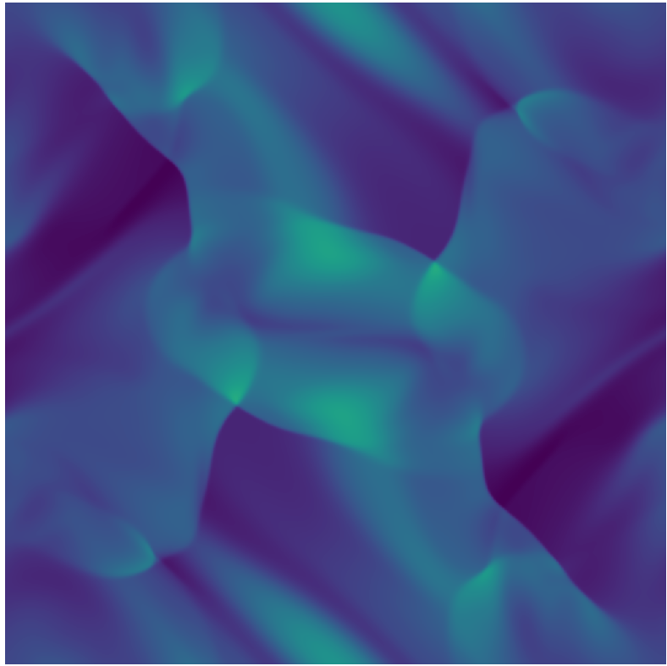
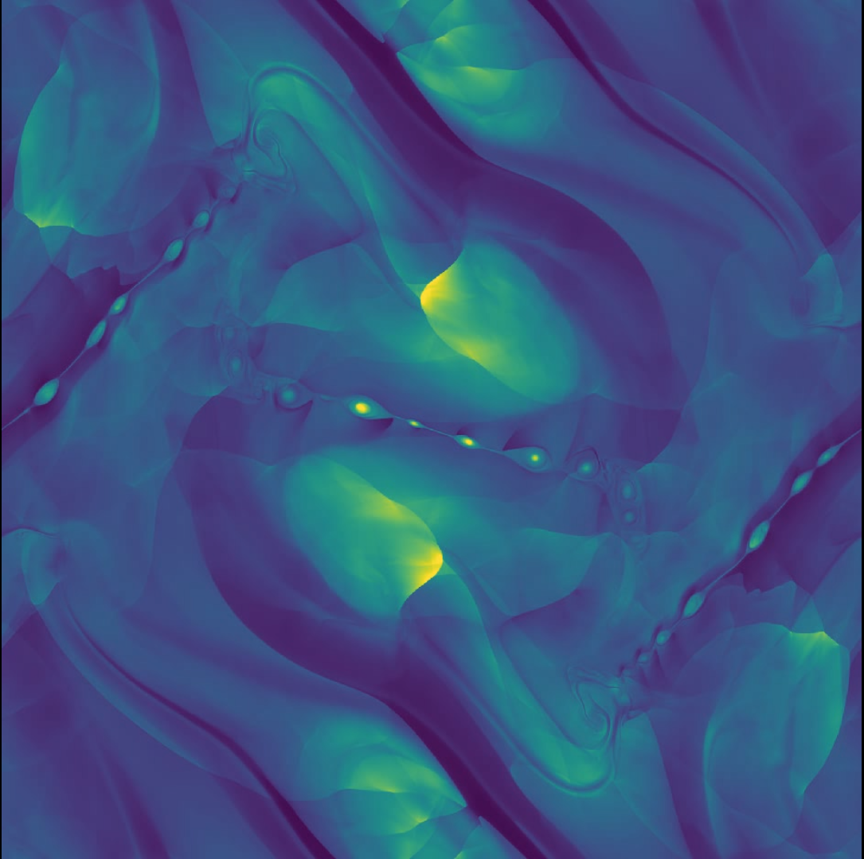
Effects of error
Two different numerical methods attempting to simulate the same problem

Slide 6
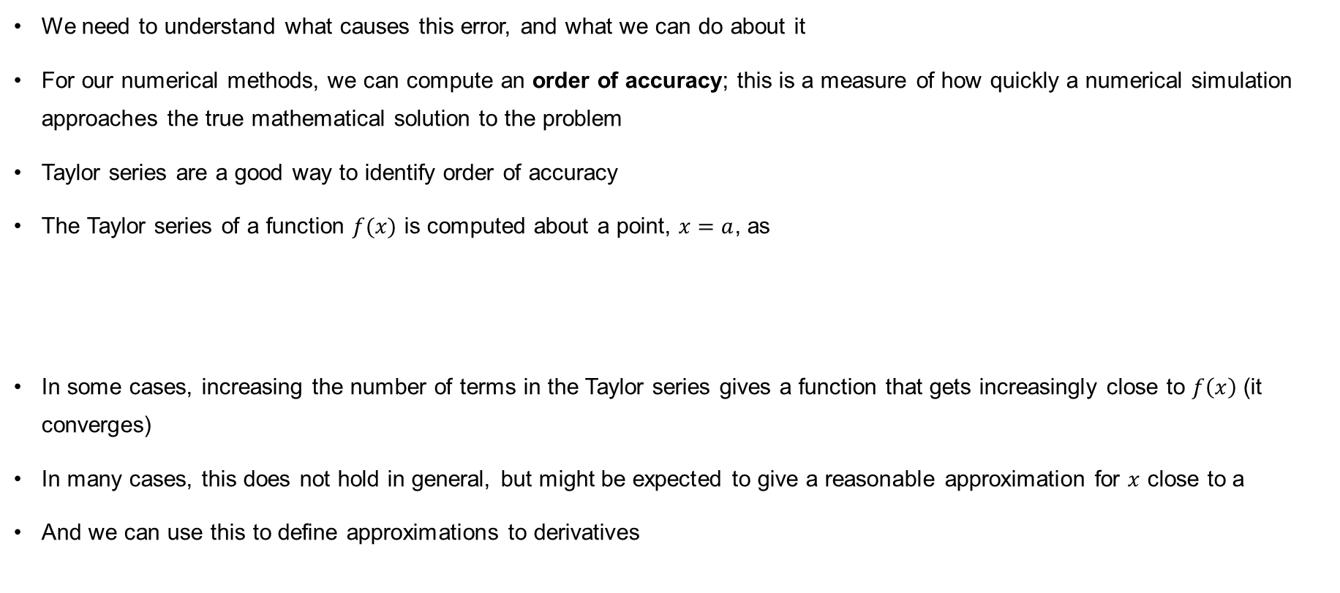
Order of accuracy
We need to understand what causes this error, and what we can do about it
For our numerical methods, we can compute an order of accuracy; this is a measure of how quickly a numerical simulation approaches the true mathematical solution to the problem
Taylor series are a good way to identify order of accuracy
The Taylor series of a function $f(x)$ is computed about a point, $x=a$, as
In some cases, increasing the number of terms in the Taylor series gives a function that gets increasingly close to $f\left(x\right)$ (it converges)
In many cases, this does not hold in general, but might be expected to give a reasonable approximation for $x$ close to a
And we can use this to define approximations to derivatives
$f\left(x\right)=f\left(a\right)+{\left.\frac{df}{dx}\right|}_{x=a}(x−a)+\frac{1}{2}{\left.\frac{d^{2}f}{dx^{2}}\right|}_{x=a}{\left(x−a\right)}^{2}$+ $\frac{1}{3!}{\left.\frac{d^{3}f}{dx^{3}}\right|}_{x=a}{\left(x−a\right)}^{3}+…$

Slide 7
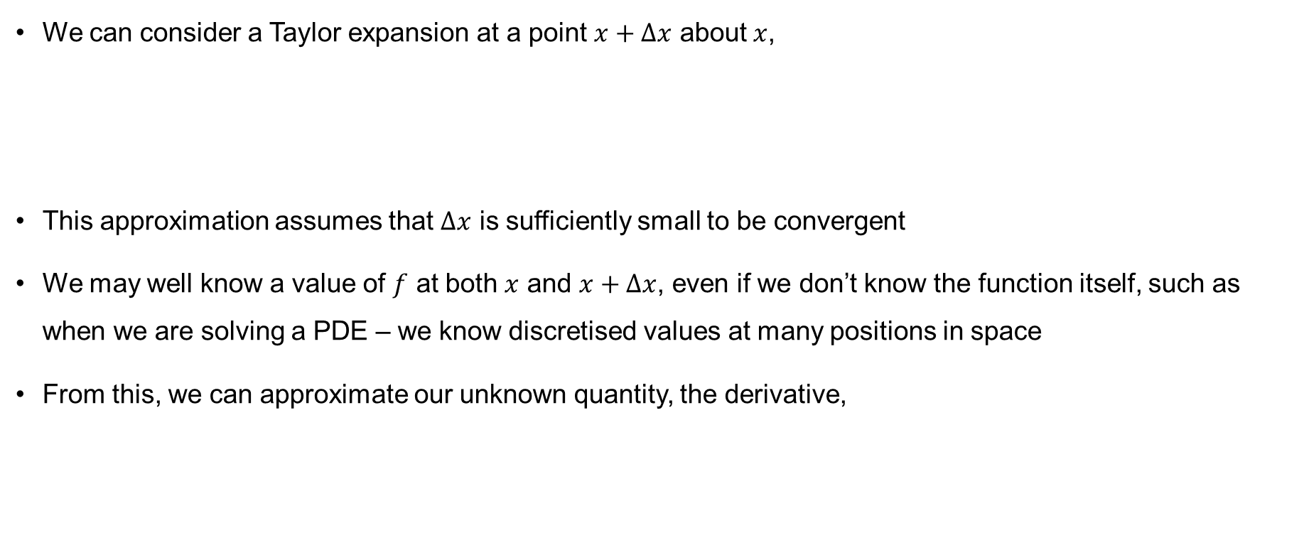
Derivative approximations
$$f\left(a+h\right)=f\left(a\right)+hf^{′}\left(a\right)+\frac{1}{2}h^{2}f^{′′}\left(a\right)+\frac{1}{6}h^{3}f^{′′′}\left(a\right)+…$$
Derivative approximations
We can consider a Taylor expansion at a point $x+∆x$ about $x$,
This approximation assumes that $∆x$ is sufficiently small to be convergent
We may well know a value of $f$ at both $x$ and $x+∆x$, even if we don’t know the function itself, such as when we are solving a PDE – we know discretised values at many positions in space
From this, we can approximate our unknown quantity, the derivative,
$f\left(x+Δx\right)=f\left(x\right)+{\left.\frac{df}{dx}\right|}_{x}Δx+\frac{1}{2}{\left.\frac{d^{2}f}{dx^{2}}\right|}_{x}{\left(Δx\right)}^{2}$+ $\frac{1}{3!}{\left.\frac{d^{3}f}{dx^{3}}\right|}_{x}{\left(Δx\right)}^{3}+…$
${\left.\frac{df}{dx}\right|}_{x}=\frac{f\left(x+Δx\right)−f\left(x\right)}{Δx}−\frac{1}{2}{\left.\frac{d^{2}f}{dx^{2}}\right|}_{x}Δx−$ $\frac{1}{3!}{\left.\frac{d^{3}f}{dx^{3}}\right|}_{x}{\left(Δx\right)}^{2}+…$

Slide 8
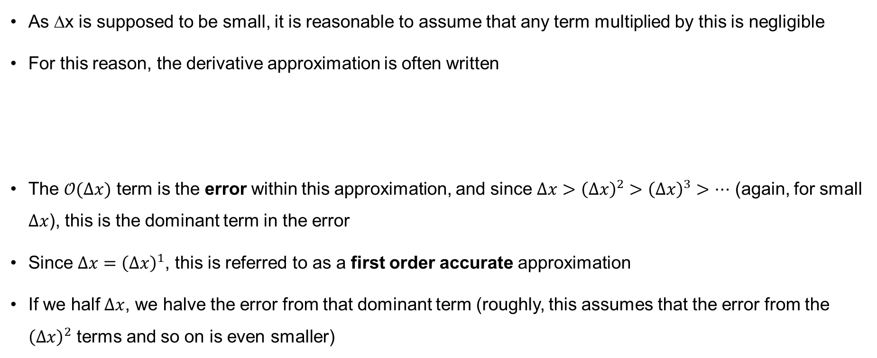
First-order derivative
As ∆x is supposed to be small, it is reasonable to assume that any term multiplied by this is negligible
For this reason, the derivative approximation is often written
The $𝒪(∆x)$ term is the error within this approximation, and since $∆x>{\left(∆x\right)}^{2}>{\left(∆x\right)}^{3}>…$ (again, for small $∆x$), this is the dominant term in the error
Since $∆x={\left(∆x\right)}^{1}$, this is referred to as a first order accurate approximation
If we half $∆x$, we halve the error from that dominant term (roughly, this assumes that the error from the ${\left(Δx\right)}^{2}$ terms and so on is even smaller)
$${\left.\frac{df}{dx}\right|}_{x}=\frac{f\left(x+Δx\right)−f\left(x\right)}{Δx}+𝒪\left(Δx\right)$$
Note that this is actually saying the derivative of a function known at two points can be approximated by drawing a straight line between the points

Slide 9
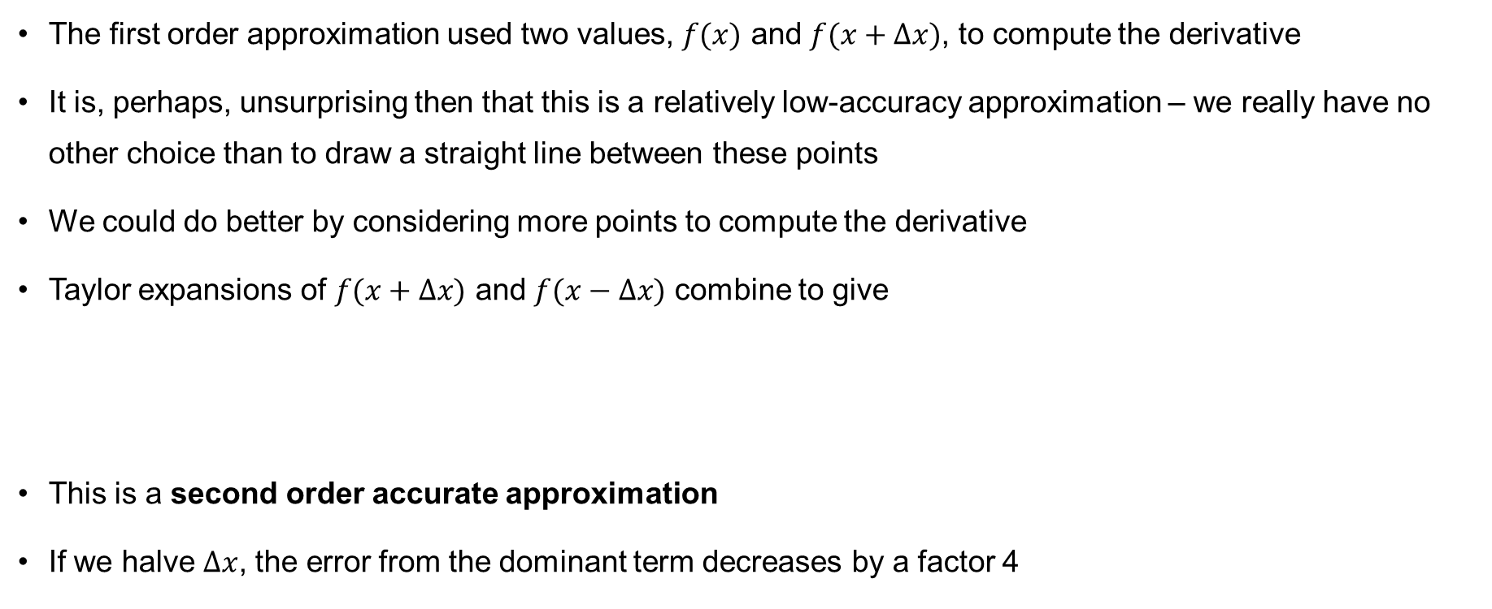
Second-order derivative
The first order approximation used two values, $f(x)$ and $f(x+∆x)$, to compute the derivative
It is, perhaps, unsurprising then that this is a relatively low-accuracy approximation – we really have no other choice than to draw a straight line between these points
We could do better by considering more points to compute the derivative
Taylor expansions of $f(x+∆x)$ and $f(x−∆x)$ combine to give
This is a second order accurate approximation
If we halve $∆x$, the error from the dominant term decreases by a factor 4
$${\left.\frac{df}{dx}\right|}_{x}=\frac{f\left(x+Δx\right)−f\left(x−Δx\right)}{2Δx}+𝒪\left(Δx^{2}\right)$$

Slide 10
Second-order approximation

Slide 11
Second-order approximation

Slide 12
Higher derivative approximation

Slide 13
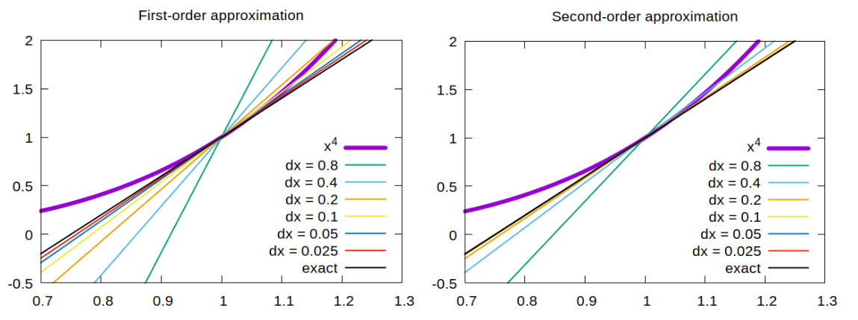
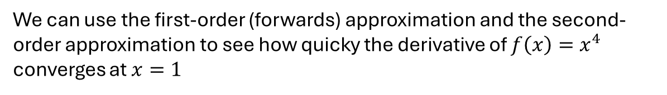
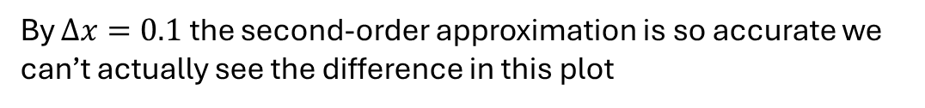
Approximating derivatives
We can use the first-order (forwards) approximation and the second-order approximation to see how quicky the derivative of $f\left(x\right)=x^{4}$ converges at $x=1$
By $Δx=0.1$ the second-order approximation is so accurate we can’t actually see the difference in this plot

Slide 14
Finding the order

Slide 15
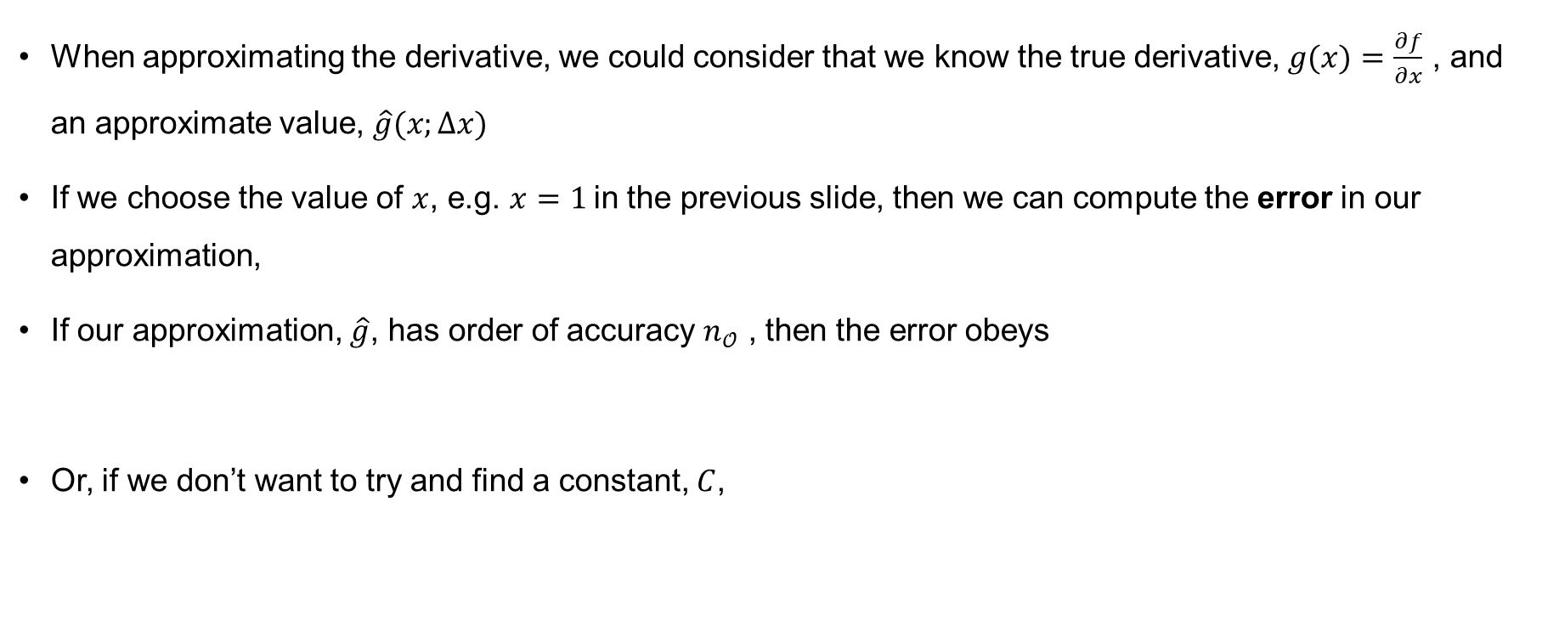
Quantifying order of accuracy
When approximating the derivative, we could consider that we know the true derivative, $g(x)=\frac{∂f}{∂x}$ , and an approximate value, $\hat{g}(x;∆x)$
If we choose the value of $x$, e.g. $x=1$in the previous slide, then we can compute the error in our approximation,
If our approximation, $\hat{g}$, has order of accuracy $n_{𝒪}$ , then the error obeys
Or, if we don’t want to try and find a constant, $C$,
NOTATION: This means we create a function of $x$ using a parameter $Δx$
$$E\left(Δx\right)=\left|g(1)−\hat{g}\left(1;∆x\right)\right|$$
When we consider error, it is always the magnitude (the absolute value) that is important
$$E\left(Δx\right)→C{\left(Δx\right)}^{n_{𝒪}} as Δx→0$$
$$ΔE=\frac{E\left(Δx_{1}\right)}{E\left(Δx_{2}\right)}→\frac{C{\left(Δx_{1}\right)}^{n_{𝒪}}}{C{\left(Δx_{2}\right)}^{n_{𝒪}}}={\left(\frac{Δx_{1}}{Δx_{2}}\right)}^{n_{𝒪}}as Δx→0$$

Slide 16
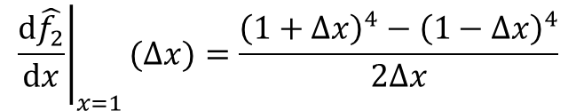
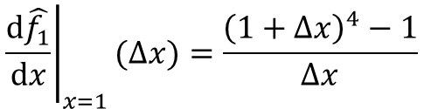
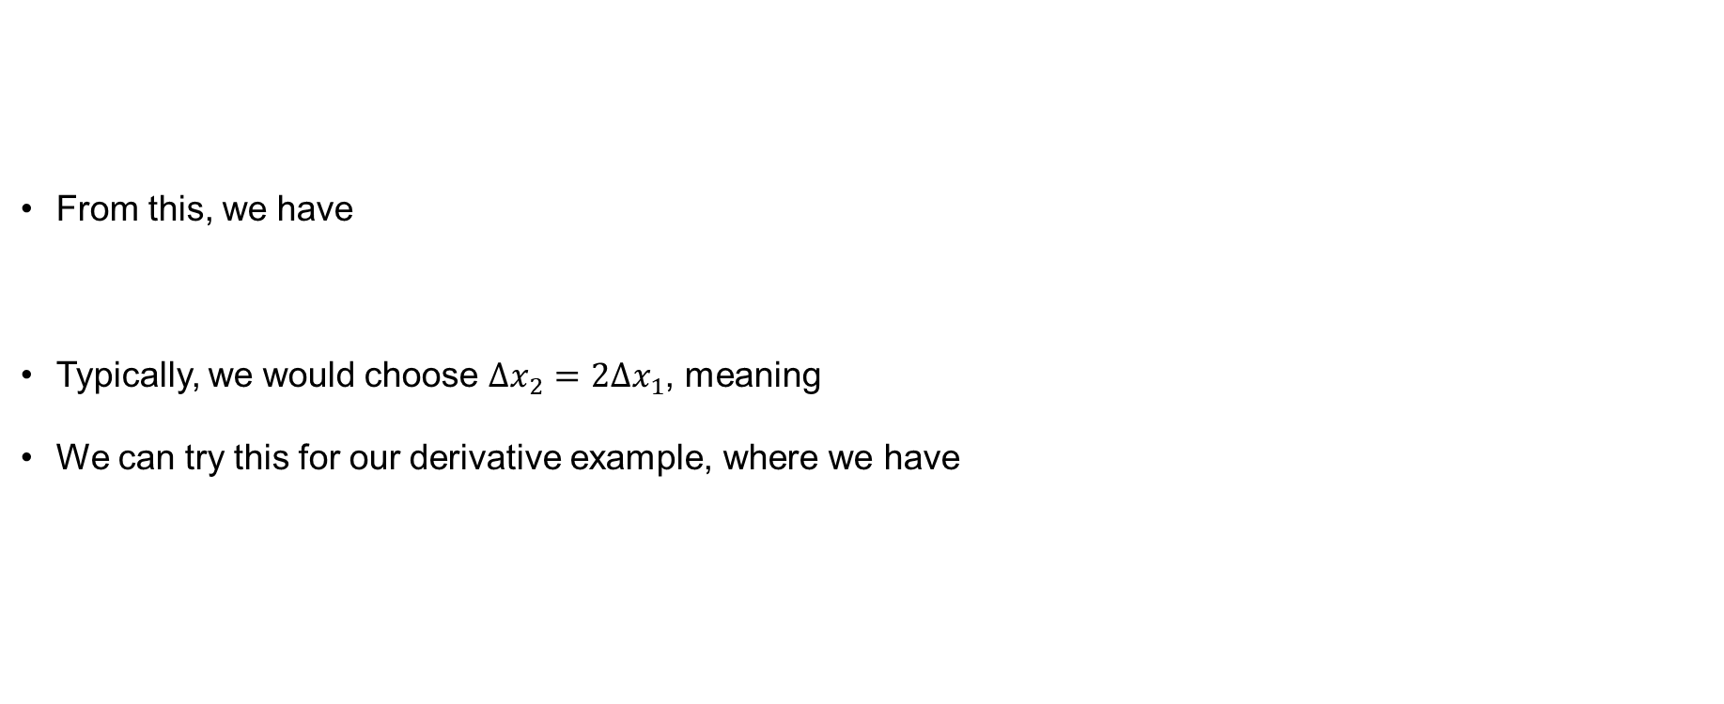
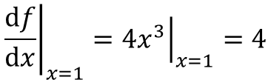

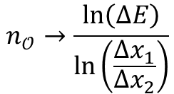
Order of accuracy
From this, we have
Typically, we would choose $∆x_{2}=2∆x_{1}$, meaning
We can try this for our derivative example, where we have
$$ΔE=\frac{E\left(Δx_{1}\right)}{E\left(Δx_{2}\right)}→\frac{C{\left(Δx_{1}\right)}^{n_{𝒪}}}{C{\left(Δx_{2}\right)}^{n_{𝒪}}}={\left(\frac{Δx_{1}}{Δx_{2}}\right)}^{n_{𝒪}}$$
$$n_{𝒪}→\frac{\ln\left(ΔE\right)}{\ln\left(\frac{Δx_{1}}{Δx_{2}}\right)}$$
$$n_{𝒪}→\frac{\ln\left(ΔE\right)}{\ln{1/2}}$$
$${\left.\frac{df}{dx}\right|}_{x=1}={\left.4x^{3}\right|}_{x=1}=4$$
$${\left.\frac{d\hat{f_{1}}}{dx}\right|}_{x=1}(Δx)=\frac{{\left(1+Δx\right)}^{4}−1}{Δx}$$
$${\left.\frac{d\hat{f_{2}}}{dx}\right|}_{x=1}(Δx)=\frac{{\left(1+Δx\right)}^{4}−{\left(1−Δx\right)}^{4}}{2Δx}$$

Slide 17
Order of accuracy – example
With f(x) = x⁴:
First-order approximation
Second-order approximation
Δx | Approx f'(1) | E₁(Δx) | ΔE₁(Δx) | n_O
0.8 | 11.872 | 7.872 | – | –
0.4 | 7.104 | 3.104 | 0.3943 | 1.34
0.2 | 5.368 | 1.368 | 0.4407 | 1.18
0.1 | 4.641 | 0.641 | 0.4684 | 1.094
0.05 | 4.310125 | 0.310125 | 0.4838 | 1.047
0.025 | 4.1525 | 0.1525 | 0.4918 | 1.024
Δx | Approx f'(1) | E₂(Δx) | ΔE₂(Δx) | n_O
0.8 | 6.56 | 2.56 | – | –
0.4 | 4.64 | 0.64 | 0.25 | 2
0.2 | 4.16 | 0.16 | 0.25 | 2
0.1 | 4.04 | 0.04 | 0.25 | 2
0.05 | 4.01 | 0.01 | 0.25 | 2
0.025 | 4.0025 | 0.0025 | 0.25 | 2
The first-order case may see regions where n_O > 1, but overall it is bounded by n_O = 1;
The second-order case shows effectively perfect convergence.

Slide 18
Additional errors

Slide 19
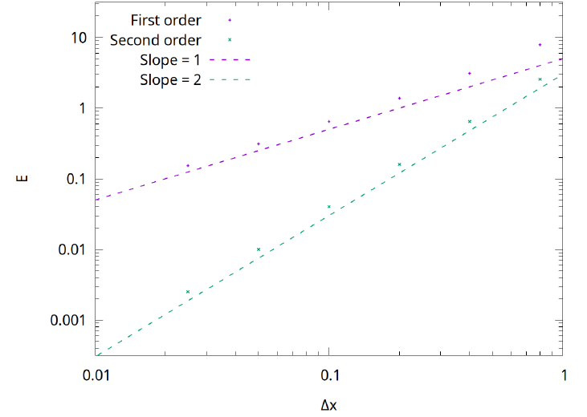
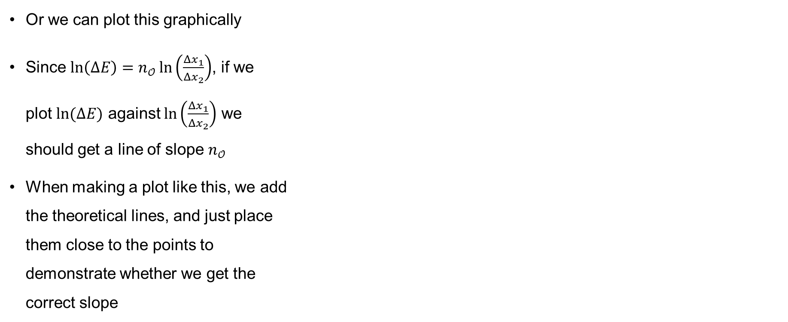
Order of accuracy – example
Or we can plot this graphically
Since $\ln\left(ΔE\right)=n_{𝒪}\ln\left(\frac{Δx_{1}}{Δx_{2}}\right)$, if we
plot $ln⁡(ΔE)$ against $\ln\left(\frac{Δx_{1}}{Δx_{2}}\right)$ we
should get a line of slope $n_{𝒪}$
When making a plot like this, we add
the theoretical lines, and just place
them close to the points to
demonstrate whether we get the
correct slope

Slide 20
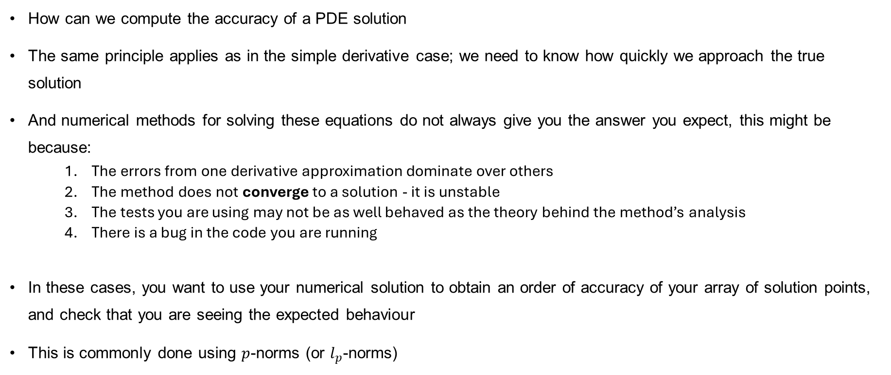
Quantifying order of accuracy
How can we compute the accuracy of a PDE solution
The same principle applies as in the simple derivative case; we need to know how quickly we approach the true solution
And numerical methods for solving these equations do not always give you the answer you expect, this might be because:
    The errors from one derivative approximation dominate over others
    The method does not converge to a solution - it is unstable
    The tests you are using may not be as well behaved as the theory behind the method’s analysis
    There is a bug in the code you are running
In these cases, you want to use your numerical solution to obtain an order of accuracy of your array of solution points, and check that you are seeing the expected behaviour
This is commonly done using $p$-norms (or $l_{p}$-norms)

Slide 21
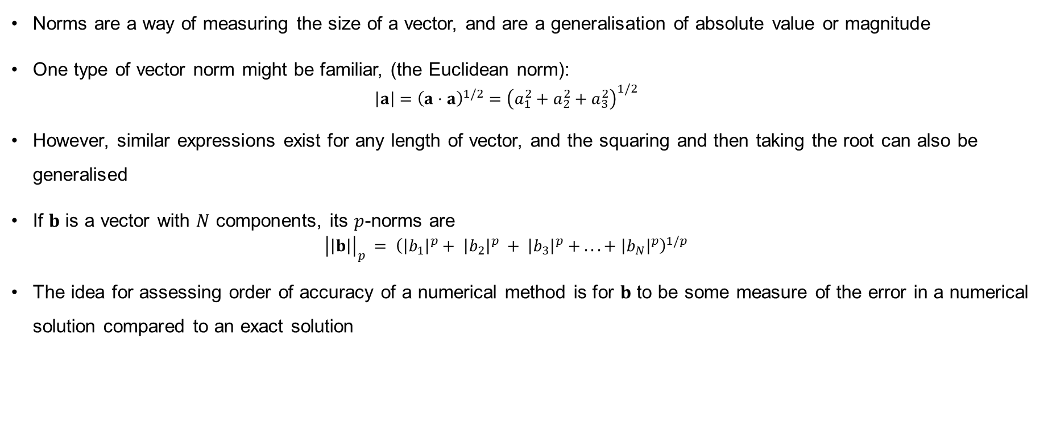
p-norms
Norms are a way of measuring the size of a vector, and are a generalisation of absolute value or magnitude
One type of vector norm might be familiar, (the Euclidean norm):
  $$\left|a\right|={\left(a⋅a\right)}^{1/2}={\left(a_{1}^{2}+a_{2}^{2}+a_{3}^{2}\right)}^{1/2}$$
However, similar expressions exist for any length of vector, and the squaring and then taking the root can also be generalised
If $b$ is a vector with $N$ components, its $p$-norms are
  $${\left|\left|b\right|\right|}_{p} = {\left({\left|b_{1}\right|}^{p}+ {\left|b_{2}\right|}^{p} + {\left|b_{3}\right|}^{p} + . . . + {\left|b_{N}\right|}^{p}\right)}^{1/p}$$
The idea for assessing order of accuracy of a numerical method is for $b$ to be some measure of the error in a numerical solution compared to an exact solution

Slide 22
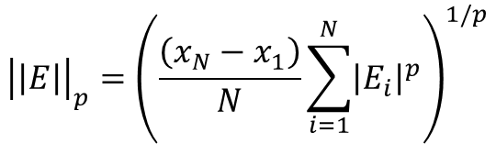
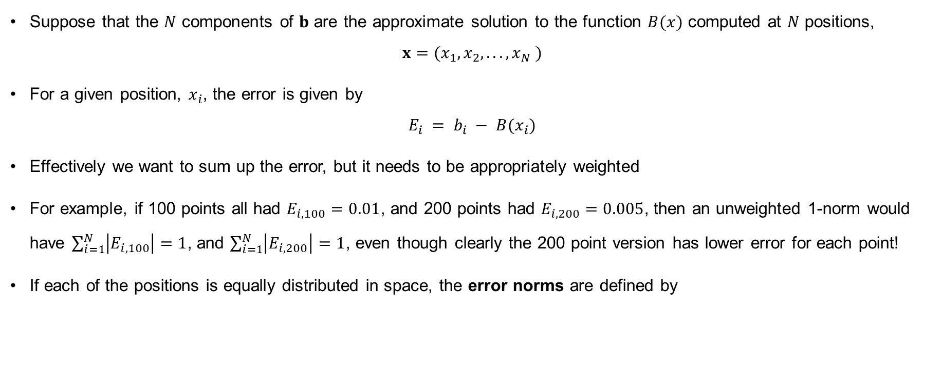
Error norms
Suppose that the $N$ components of $b$ are the approximate solution to the function $B(x)$ computed at $N$ positions,
$x=(x_{1}, x_{2}, . . . , x_{N} )$
For a given position, $x_{i}$, the error is given by
$$E_{i} = b_{i} − B(x_{i})$$
Effectively we want to sum up the error, but it needs to be appropriately weighted
For example, if 100 points all had $E_{i,100}=0.01$, and 200 points had $E_{i,200}=0.005$, then an unweighted 1-norm would have $\sum_{i=1}^{N}{\left|E_{i,100}\right|=1}$, and $\sum_{i=1}^{N}{\left|E_{i,200}\right|=1}$, even though clearly the 200 point version has lower error for each point!
If each of the positions is equally distributed in space, the error norms are defined by
$${\left|\left|E\right|\right|}_{p}={\left(\frac{\left(x_{N}−x_{1}\right)}{N}\sum_{i=1}^{N}{{\left|E_{i}\right|}^{p}}\right)}^{1/p}$$

Slide 23
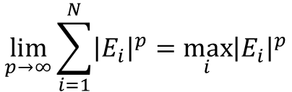
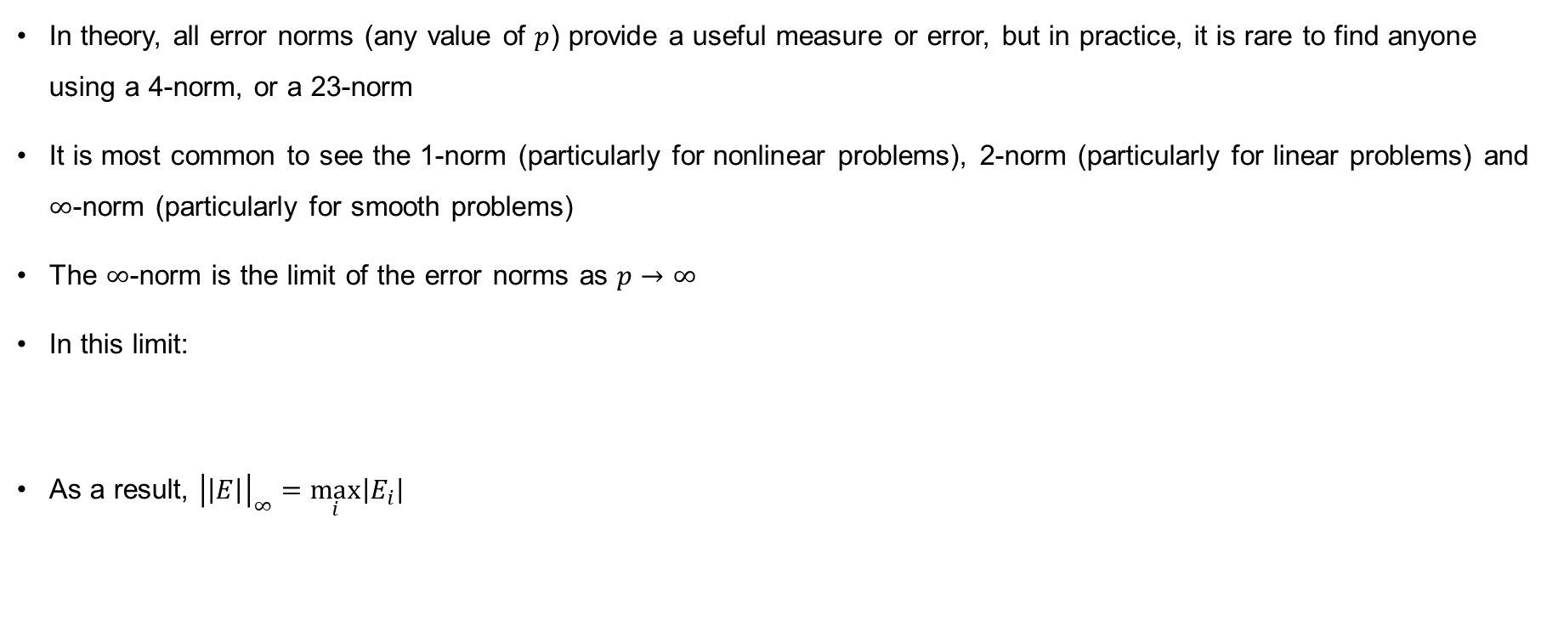

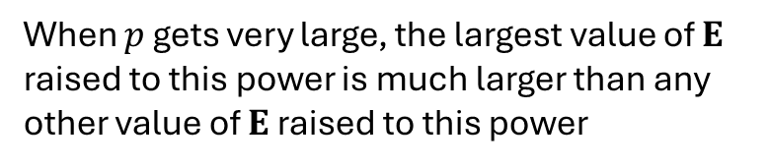
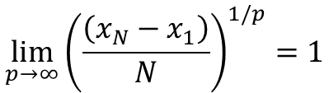
Common error norms
In theory, all error norms (any value of $p$) provide a useful measure or error, but in practice, it is rare to find anyone using a 4-norm, or a 23-norm
It is most common to see the 1-norm (particularly for nonlinear problems), 2-norm (particularly for linear problems) and $∞$-norm (particularly for smooth problems)
The $∞$-norm is the limit of the error norms as $p→∞$
In this limit:
As a result, ${\left|\left|E\right|\right|}_{∞}=\max_{i}\left|E_{i}\right|$
When $p$ gets very large, the largest value of $E$ raised to this power is much larger than any other value of $E$ raised to this power
$$\lim_{p→∞}{\sum_{i=1}^{N}{{\left|E_{i}\right|}^{p}}}=\max_{i}{{\left|E_{i}\right|}^{p}}$$
$$\lim_{p→∞}{{\left(\frac{\left(x_{N}−x_{1}\right)}{N}\right)}^{1/p}}=1$$
As $p→∞$, $\frac{1}{p}→0$, and $a^{0}=1$

Slide 24
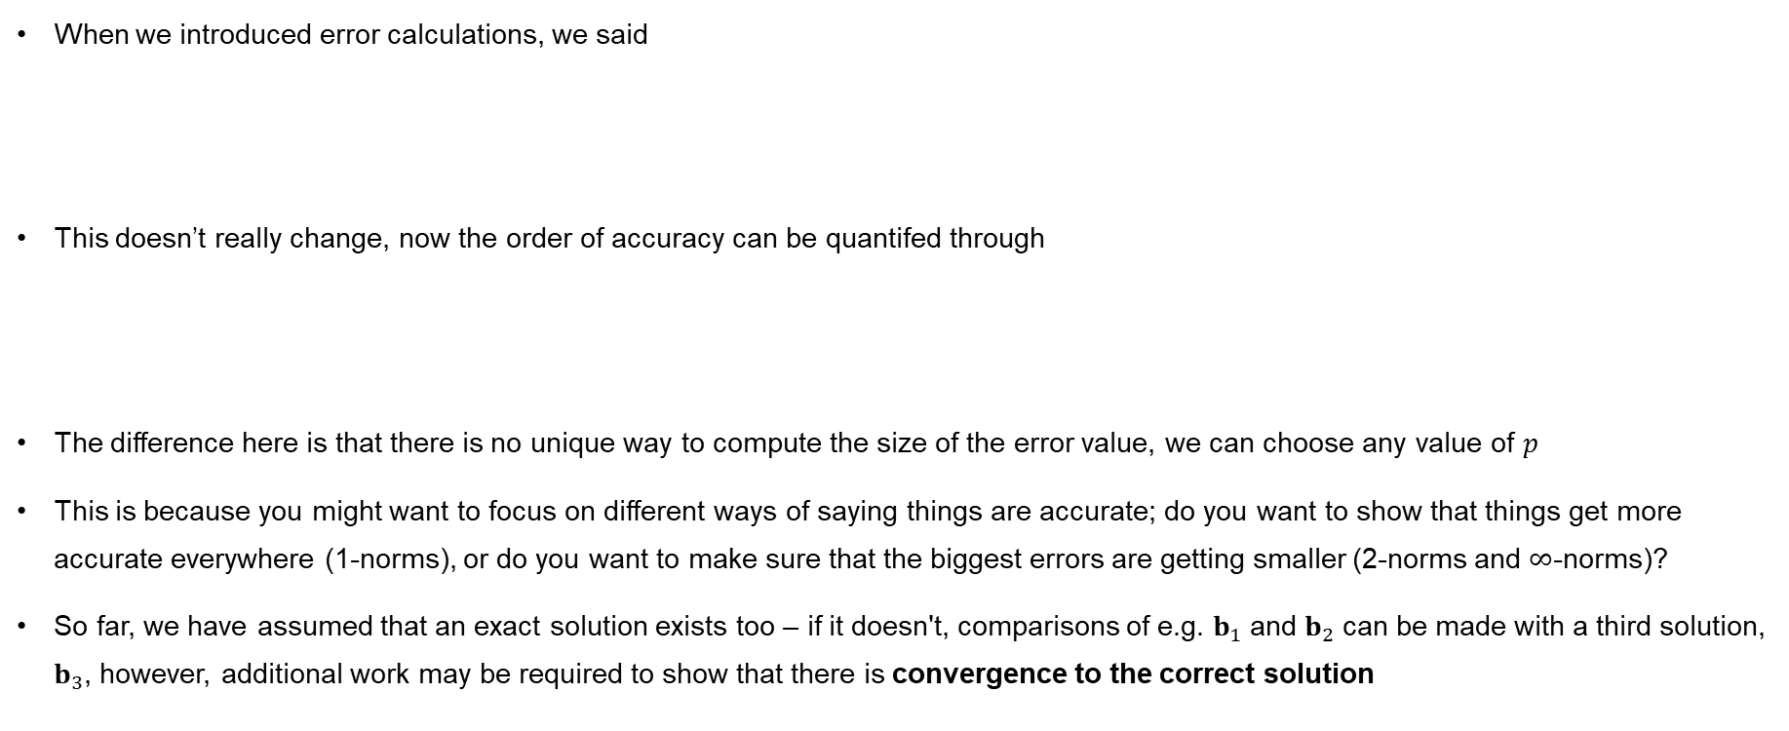
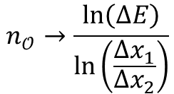

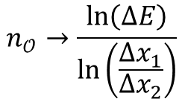

Error norms
When we introduced error calculations, we said
This doesn’t really change, now the order of accuracy can be quantifed through
The difference here is that there is no unique way to compute the size of the error value, we can choose any value of $p$
This is because you might want to focus on different ways of saying things are accurate; do you want to show that things get more accurate everywhere (1-norms), or do you want to make sure that the biggest errors are getting smaller (2-norms and $∞$-norms)?
So far, we have assumed that an exact solution exists too – if it doesn't, comparisons of e.g. $b_{1}$ and $b_{2}$ can be made with a third solution, $b_{3}$, however, additional work may be required to show that there is convergence to the correct solution
$$ΔE=\frac{E\left(Δx_{1}\right)}{E\left(Δx_{2}\right)}→{\left(\frac{Δx_{1}}{Δx_{2}}\right)}^{n_{𝒪}}$$
$$n_{𝒪}→\frac{\ln\left(ΔE\right)}{\ln\left(\frac{Δx_{1}}{Δx_{2}}\right)}$$
$$ΔE=\frac{{\left|\left|E\left(Δx_{1}\right)\right|\right|}_{p}}{{\left|\left|E\left(Δx_{2}\right)\right|\right|}_{p}}→{\left(\frac{Δx_{1}}{Δx_{2}}\right)}^{n_{𝒪}}$$
$$n_{𝒪}→\frac{\ln\left(ΔE\right)}{\ln\left(\frac{Δx_{1}}{Δx_{2}}\right)}$$

Slide 25
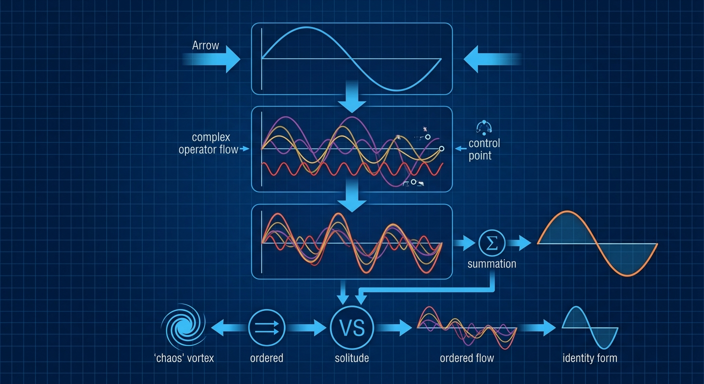
Fourier Series (briefly)

Slide 26
Fourier series
Error norms are a practical technique to show that a numerical solution is converging
Fourier series can be used to provide a theoretical technique for finding when a numerical solution will converge
Methods to actually do this will be found in other courses, we provide a brief overview of some important properties of Fourier series here
Recall, Fourier series represent a periodic function as a sum of trigonometric functions

Slide 27
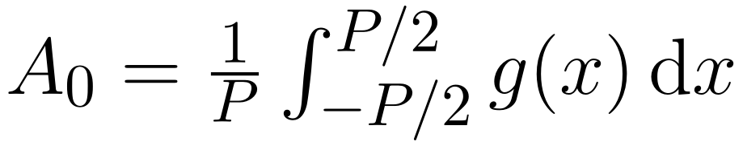
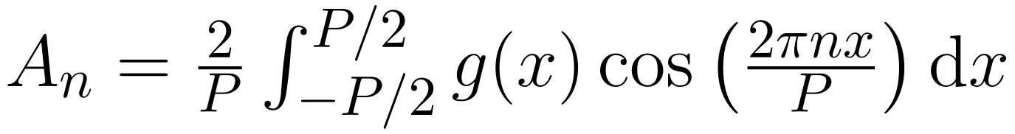
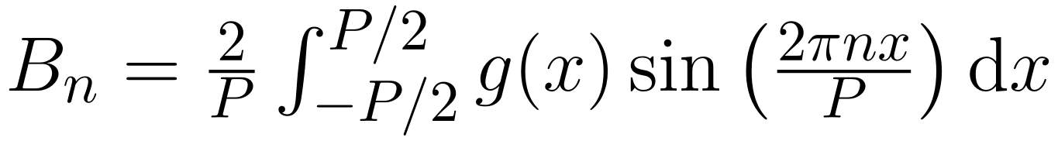
Computing Fourier series
For a given function, g(x), with periodicity, P, the constants of the Fourier series are given by
The idea behind using Fourier series in computing convergence, however, is not to compute these quantities, but to find when they are bounded
If a solution is found on a finite domain, then by replicating this domain, it is straightforward to make it periodic
We can express the solution, or its error, as a Fourier series

Slide 28
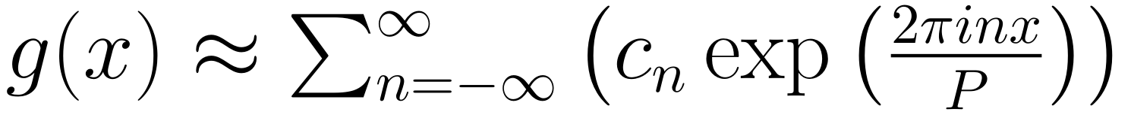
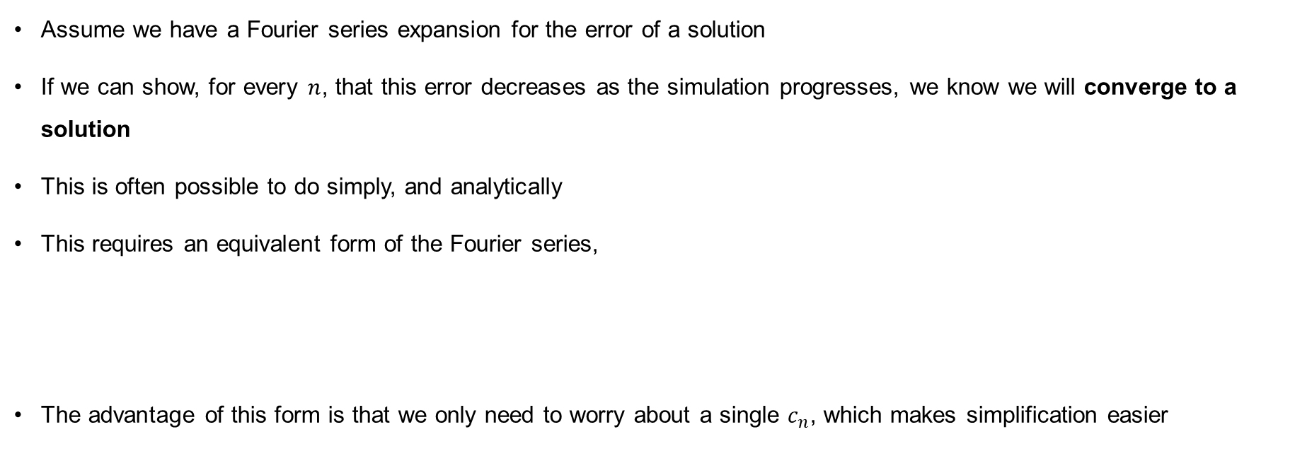
Converging solutions
Assume we have a Fourier series expansion for the error of a solution
If we can show, for every $n$, that this error decreases as the simulation progresses, we know we will converge to a solution
This is often possible to do simply, and analytically
This requires an equivalent form of the Fourier series,
The advantage of this form is that we only need to worry about a single $c_{n}$, which makes simplification easier

Slide 29
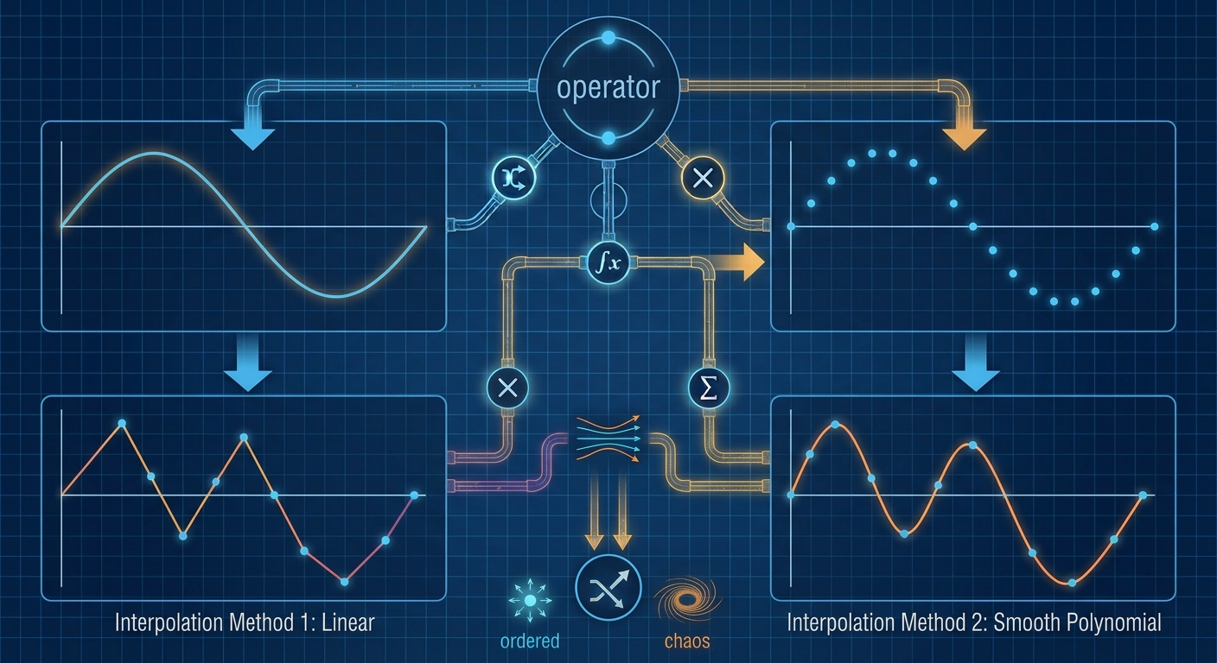
Interpolation

Slide 30
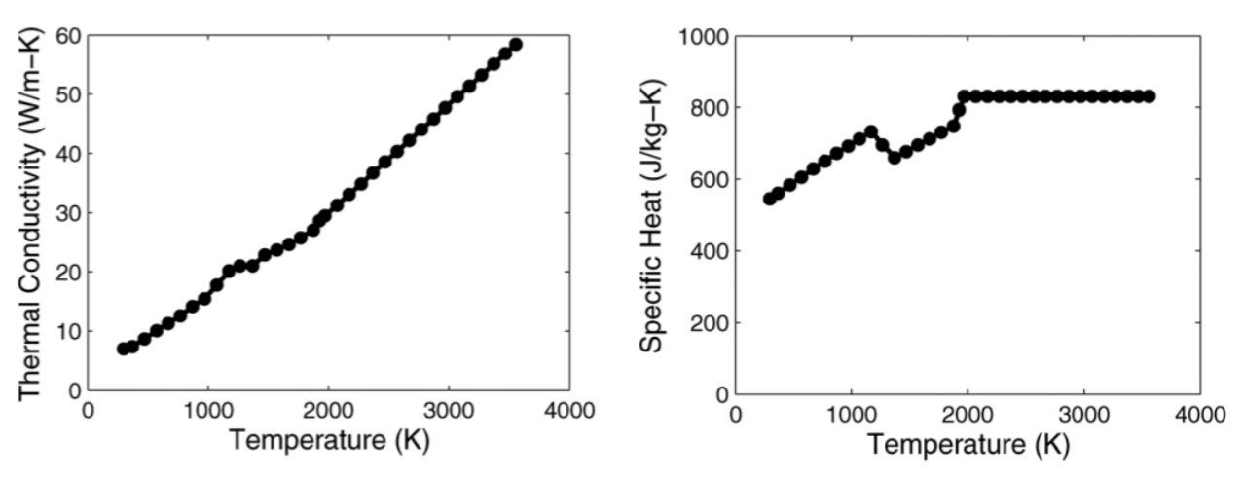
Discretisation and interpolation
When we have a solution on discrete space, we may need information about points in between these known values
This could be for identifying material interfaces, identifying contours or determining material properties
To achieve this, we may find we need to interpolate data

Slide 31
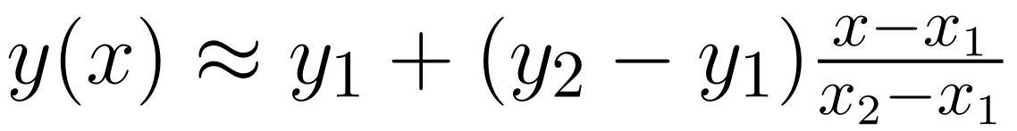
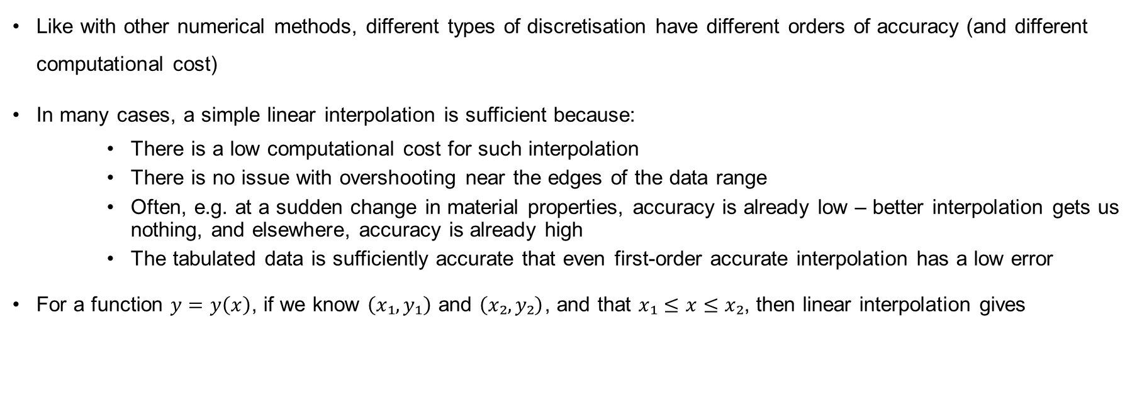
Discretisation and interpolation
Like with other numerical methods, different types of discretisation have different orders of accuracy (and different computational cost)
In many cases, a simple linear interpolation is sufficient because:
    There is a low computational cost for such interpolation
    There is no issue with overshooting near the edges of the data range
    Often, e.g. at a sudden change in material properties, accuracy is already low – better interpolation gets us nothing, and elsewhere, accuracy is already high
    The tabulated data is sufficiently accurate that even first-order accurate interpolation has a low error
For a function $y=y\left(x\right)$, if we know $\left(x₁,y₁\right)$ and $\left(x₂,y₂\right)$, and that $x₁≤x≤x₂$, then linear interpolation gives

Slide 32
Linear interpolation

Slide 33
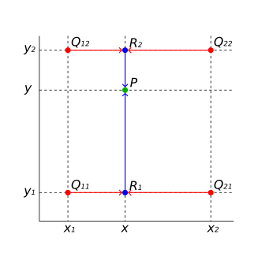
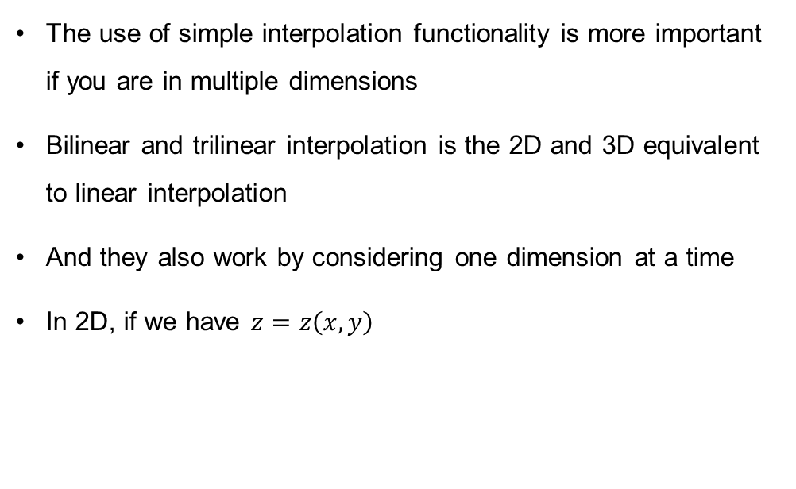
Bilinear and trilinear interpolation
The use of simple interpolation functionality is more important if you are in multiple dimensions
Bilinear and trilinear interpolation is the 2D and 3D equivalent to linear interpolation
And they also work by considering one dimension at a time
In 2D, if we have $z=z\left(x,y\right)$

Slide 34
Other interpolation
Bilinear and trilinear interpolation work in very similar ways, taking one direction at a time
The order of the direction is also unimportant
If more accurate interpolation is needed, spline interpolation exists in 1D, bicubic in 2D and tricubic in 3D
In order to get greater accuracy, however, more points are needed, 16 in the case of bicubic interpolation, and 64 in the case of tricubic

Slide 35
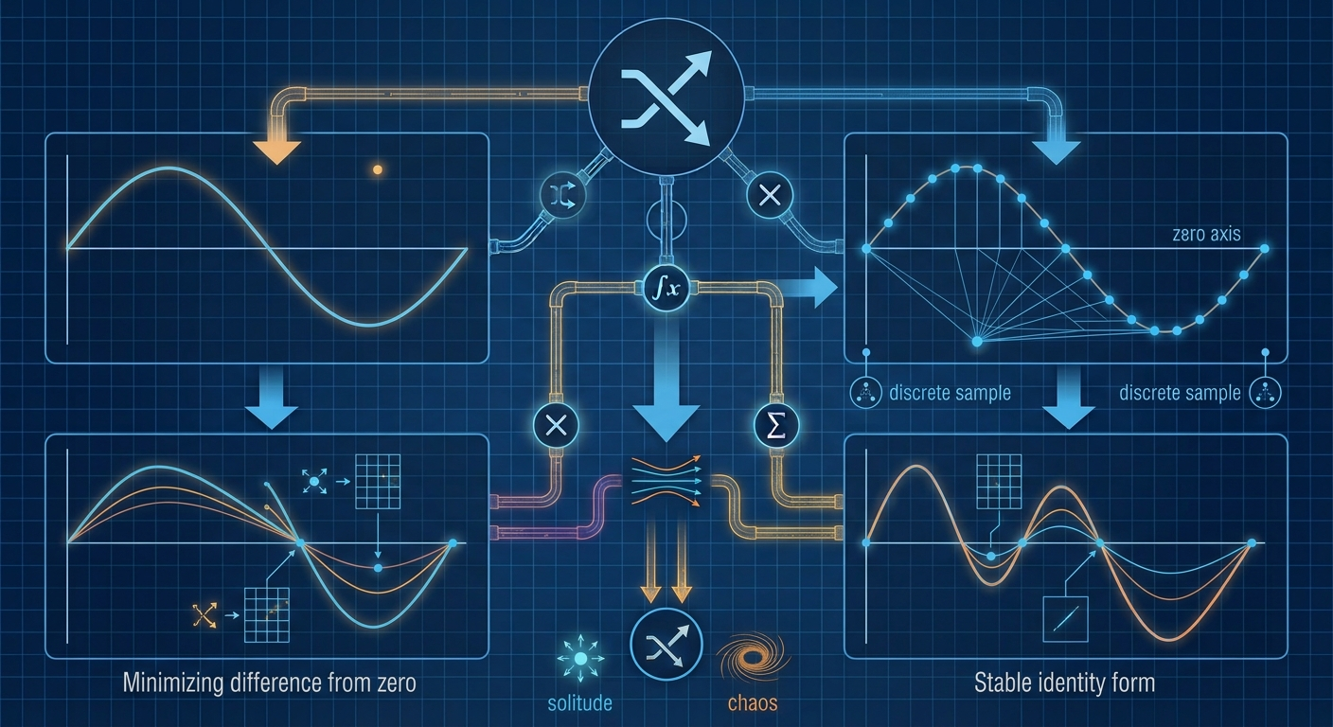
Root finding

Slide 36
Iterative solutions in this course
Many of your other courses will probably involve specific iterative solution techniques (numerical methods) for a given system or form of equations
In this course, we consider the techniques which could be classed as an iterative solution, but are general, and found across a range of applications, starting with root finding
One of the problems with scientific computing is it often involves real materials, and these often don’t have nice, easy-to-work-with equations describing them
Consider, for example, this expression:
This describes part of the energy of a metal (for example aluminium), it may not be an equation you actually have to worry about in detail
Entropy
Other variables computed from density
$$ε=\frac{K_{0}}{2α_{R}^{2}}{\left(I_{3}^{α_{R}/2}−1\right)}^{2}+c_{V}T_{0}I_{3}^{γ_{R}/2}\left(e^{s/c_{v}}−1\right)+\frac{b_{0}^{2}}{2}I_{3}^{β_{R}/2}\left(\frac{I_{1}^{2}}{3}−I_{2}\right)$$
(Internal) energy
Everything else is a constant
Variable computed from density

Slide 37
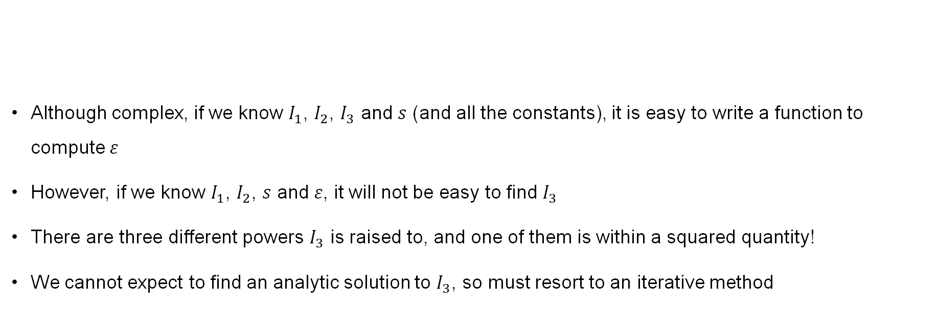
Iterative solutions
Although complex, if we know $I_{1}$, $I_{2}$, $I_{3}$ and $s$ (and all the constants), it is easy to write a function to compute $ε$
However, if we know $I_{1}$, $I_{2}$, $s$ and $ε$, it will not be easy to find $I_{3}$
There are three different powers $I_{3}$ is raised to, and one of them is within a squared quantity!
We cannot expect to find an analytic solution to $I_{3}$, so must resort to an iterative method
$$ε=\frac{K_{0}}{2α_{R}^{2}}{\left(I_{3}^{α_{R}/2}−1\right)}^{2}+c_{V}T_{0}I_{3}^{γ_{R}/2}\left(e^{s/c_{v}}−1\right)+\frac{b_{0}^{2}}{2}I_{3}^{β_{R}/2}\left(\frac{I_{1}^{2}}{3}−I_{2}\right)$$

Slide 38
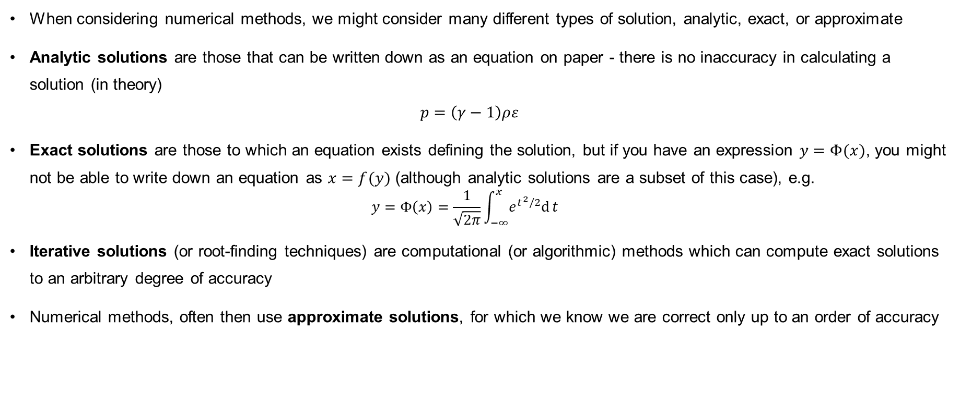
Analytic, exact and approximate solutions
When considering numerical methods, we might consider many different types of solution, analytic, exact, or approximate
Analytic solutions are those that can be written down as an equation on paper - there is no inaccuracy in calculating a solution (in theory)
$p=\left(γ−1\right)ρε$
Exact solutions are those to which an equation exists defining the solution, but if you have an expression $y=Φ(x)$, you might not be able to write down an equation as $x=f(y)$ (although analytic solutions are a subset of this case), e.g.
  $$y=Φ\left(x\right)=\frac{1}{\sqrt{2π}}\int_{−∞}^{x}{e^{t^{2}/2}\text{d}}t$$
Iterative solutions (or root-finding techniques) are computational (or algorithmic) methods which can compute exact solutions to an arbitrary degree of accuracy
Numerical methods, often then use approximate solutions, for which we know we are correct only up to an order of accuracy

Slide 39
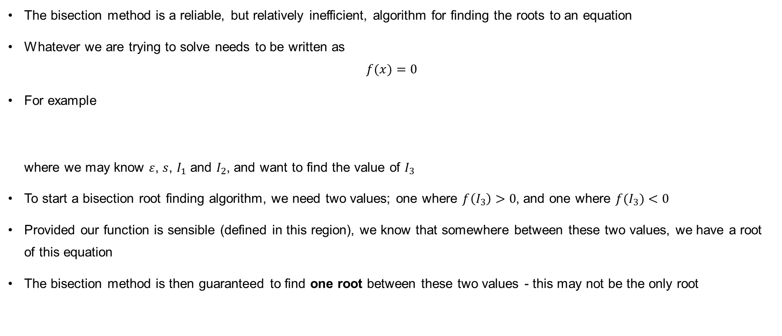
Bisection method
The bisection method is a reliable, but relatively inefficient, algorithm for finding the roots to an equation
Whatever we are trying to solve needs to be written as
$f(x)=0$
For example
where we may know $ε$, $s$, $I_{1}$ and $I_{2}$, and want to find the value of $I_{3}$
To start a bisection root finding algorithm, we need two values; one where $f\left(I_{3}\right)>0$, and one where $f(I_{3})<0$
Provided our function is sensible (defined in this region), we know that somewhere between these two values, we have a root of this equation
The bisection method is then guaranteed to find one root between these two values - this may not be the only root
$$f\left(I_{3}\right)=ε−\frac{K_{0}}{2α_{R}^{2}}{\left(I_{3}^{α_{R}/2}−1\right)}^{2}+c_{V}T_{0}I_{3}^{γ_{R}/2}\left(e^{s/c_{v}}−1\right)+\frac{b_{0}^{2}}{2}I_{3}^{β_{R}/2}\left(\frac{I_{1}^{2}}{3}−I_{2}\right)=0$$

Slide 40
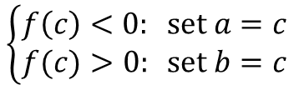
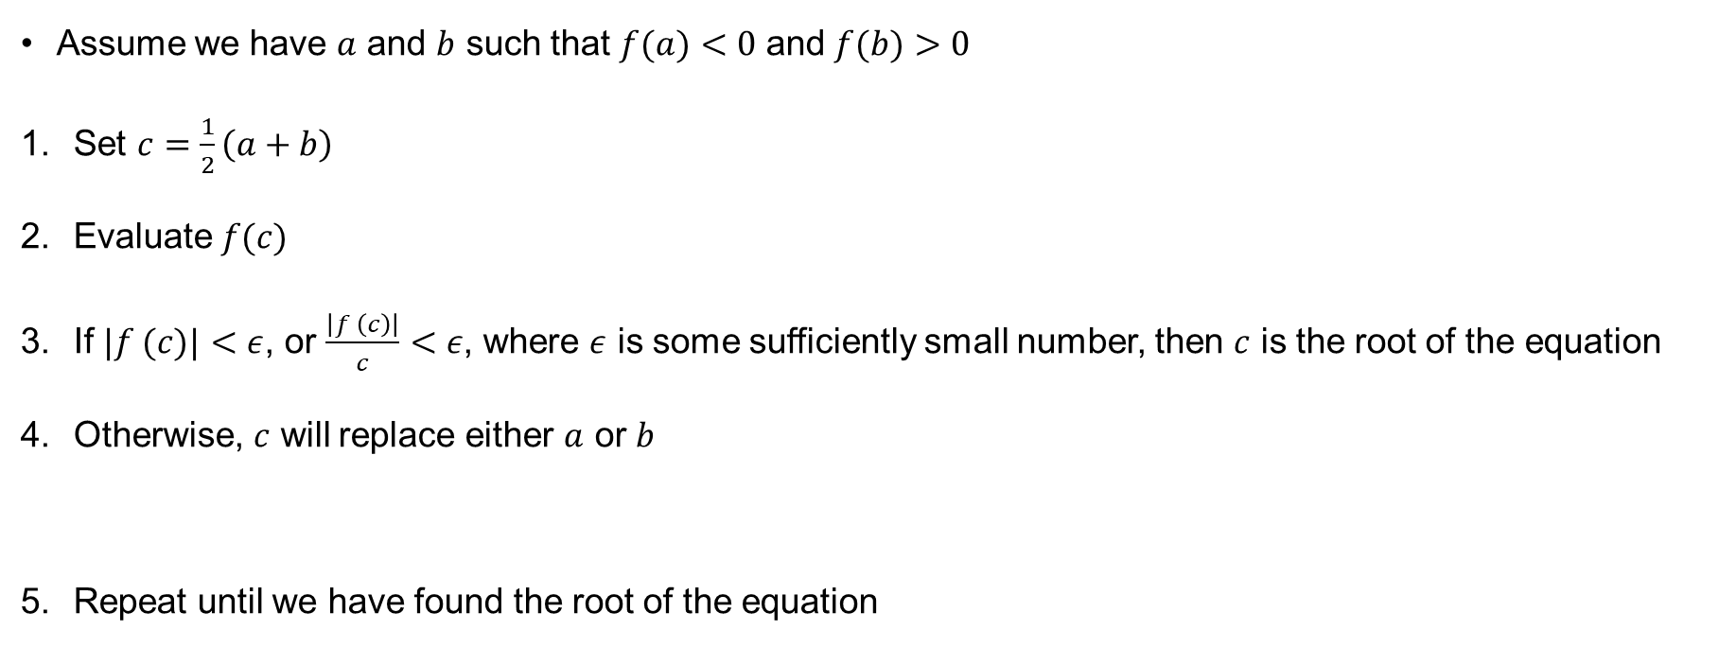
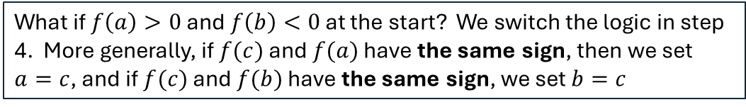
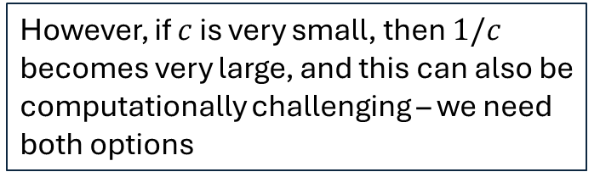
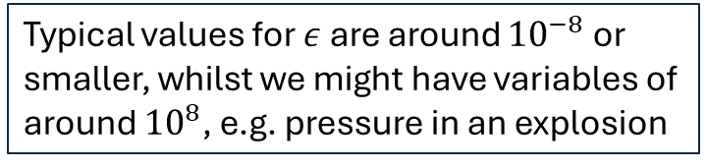
Bisection method
We have two checks here – the first checks the absolute error, and the second the relative error
Assume we have $a$ and $b$ such that $f(a)<0$ and $f(b)>0$
Set $c=\frac{1}{2}\left(a+b\right)$
Evaluate $f(c)$
If $|f (c)|<ε$, or $\frac{\left|f \left(c\right)\right|}{c}<ε$, where $ε$ is some sufficiently small number, then $c$ is the root of the equation
Otherwise, $c$ will replace either $a$ or $b$
Repeat until we have found the root of the equation
Typical values for $ε$ are around ${10}^{−8}$ or smaller, whilst we might have variables of around ${10}^{8}$, e.g. pressure in an explosion
Computationally, achieving the absolute error might be very challenging, so we use relative error
$$\left\{\begin{aligned}f\left(c\right)<0: \text{set }a=c \\ f(c)>0: \text{set} b=c\end{aligned}\right.$$
However, if $c$ is very small, then $1/c$ becomes very large, and this can also be computationally challenging – we need both options
What if $f\left(a\right)>0$ and $f\left(b\right)<0$ at the start? We switch the logic in step 4. More generally, if $f(c)$ and $f(a)$ have the same sign, then we set $a=c$, and if $f(c)$ and $f(b)$ have the same sign, we set $b=c$

Slide 41





Bisection method – an example
We find that $f\left(0\right)=−4<0$ and $f\left(2\right)=4>0$
$$c=\frac{1}{2}\left(a+b\right)$$
$a=0, b=2$ so $c=1$
$$\left\{\begin{aligned}f\left(c\right)<0: \text{set }a=c \\ f(c)>0: \text{set} b=c\end{aligned}\right.$$

Slide 42




Bisection method
We find that $f\left(0\right)<0$ and $f\left(2\right)>0$
$$c=\frac{1}{2}\left(a+b\right)$$
$a=0, b=2$ so $c=1$
$$\left\{\begin{aligned}f\left(c\right)<0: \text{set }a=c \\ f(c)>0: \text{set} b=c\end{aligned}\right.$$
$f\left(1\right)<0$ so we replace $a$
Now $a=1, b=2, c=1.5$

Slide 43


Bisection method
$$c=\frac{1}{2}\left(a+b\right)$$
$$a=1, b=2, c=1.5 \\ f\left(1.5\right)>0$$
Now $a=1,b=1.5,c=1.25$
$$\left\{\begin{aligned}f\left(c\right)<0: \text{set }a=c \\ f(c)>0: \text{set} b=c\end{aligned}\right.$$

Slide 44

Bisection method
And so on…
$$c=\frac{1}{2}\left(a+b\right)$$
$$\left\{\begin{aligned}f\left(c\right)<0: \text{set }a=c \\ f(c)>0: \text{set} b=c\end{aligned}\right.$$

Slide 45


Bisection method
$$c=\frac{1}{2}\left(a+b\right)$$
$$\left\{\begin{aligned}f\left(c\right)<0: \text{set }a=c \\ f(c)>0: \text{set} a=b\end{aligned}\right.$$

Slide 46

Bisection method
$$c=\frac{1}{2}\left(a+b\right)$$
$$\left\{\begin{aligned}f\left(c\right)<0: \text{set }a=c \\ f(c)>0: \text{set} b=c\end{aligned}\right.$$

Slide 47

Bisection method
$$c=\frac{1}{2}\left(a+b\right)$$
$$\left\{\begin{aligned}f\left(c\right)<0: \text{set }a=c \\ f(c)>0: \text{set} b=c\end{aligned}\right.$$

Slide 48

Bisection method
$$c=\frac{1}{2}\left(a+b\right)$$
$$\left\{\begin{aligned}f\left(c\right)<0: \text{set }a=c \\ f(c)>0: \text{set} b=c\end{aligned}\right.$$

Slide 49

Bisection method
Looks pretty close now!
$$c=\frac{1}{2}\left(a+b\right)$$
$$\left\{\begin{aligned}f\left(c\right)<0: \text{set }a=c \\ f(c)>0: \text{set} b=c\end{aligned}\right.$$

Slide 50

Bisection method
After 6 iterations:
$c=1.296875$
$$f(c)=0.004925$$

Slide 51

Notes on the bisection method
The bisection method’s guess does not always have to get closer to the root
Generally, physical parameters are often ‘well-behaved’ - they increase or decrease monotonically
But not always - in these cases, more physical information about the system may be required to ensure you have the correct root
For example, water. Usually, when temperature increases, density decreases
But below $4^{∘}$C, density increases as temperature increases, density alone is not always enough to work out water’s temperature
The method does require you to find two suitable guesses - these are often obvious, but problem dependent. You may have a starting guess from the previous time this method was called, for example

Slide 52
Newton's method
The bisection method is reliable, simple, but inefficient
Under certain measures, it is the best method which is guaranteed to find a root
In a numerical simulation, however, root finding may need to be done a lot - inefficient is not good
Newton’s method, which is efficient, simple, and usually reliable, is a popular choice to improve things
The idea behind the method is that if, for any single guess, we follow the slope of the derivative down to the axis, we get closer to the solution

Slide 53

Newton's method
For Newton’s method, we make an initial guess, $x_{n}$, for which we know $f(x_{n})$
For the method to work, we need to know the derivative of $f(x)$, and be able to calculate it at $x_{n}$
We then find the point $x_{n+1}$ such that the for the tangent line to the function at $x_{n}$, $t(x_{n+1}) = 0$
Fortunately, this is straightforward, since, for a straight line
${\left.\frac{∂f}{∂x}\right|}_{x=x_{n}}=\frac{0−f\left(x_{n}\right)}{x_{n+1}−x_{n}}=\frac{f\left(x_{n}\right)−0}{x_{n}−x_{n+1}}$
Our new guess for x is then
$x_{n+1}=x_{n}−\frac{f\left(x_{n}\right)}{f^{′}\left(x_{n}\right)}$
If $f\left(x_{n+1}\right)<ε$then we have converged
Otherwise, repeat the above formula to get $x_{n+2}$ and continue until convergence

Slide 54
Newton-Raphson derivation

Slide 55


Newton’s method
Choose $x_{0}=1$
$$x_{n+1}=x_{n}−\frac{f\left(x_{n}\right)}{f^{′}\left(x_{n}\right)}$$

Slide 56


Newton’s method
$$f\left(x_{0}\right)=−1 \\ f^{′}\left(x_{0}\right)=3$$
$$x_{n+1}=x_{n}−\frac{f\left(x_{n}\right)}{f^{′}\left(x_{n}\right)}$$

Slide 57

Newton’s method
$$x_{1}=x_{0}−\frac{f\left(x_{0}\right)}{f^{′}\left(x_{0}\right)} \\ x_{1}=1−\frac{−1}{3}=\frac{4}{3}$$
$$x_{n+1}=x_{n}−\frac{f\left(x_{n}\right)}{f^{′}\left(x_{n}\right)}$$

Slide 58

Newton’s method
For Newton’s method, we are already close to the root!
$$x_{n+1}=x_{n}−\frac{f\left(x_{n}\right)}{f^{′}\left(x_{n}\right)}$$

Slide 59

Newton’s method
Let’s apply Newton’s method again to get even closer
$$x_{n+1}=x_{n}−\frac{f\left(x_{n}\right)}{f^{′}\left(x_{n}\right)}$$

Slide 60

Newton’s method
$$x_{n+1}=x_{n}−\frac{f\left(x_{n}\right)}{f^{′}\left(x_{n}\right)}$$

Slide 61
Newton’s method
After 2 iterations:
c = 1.2963
f (c) = 0.002967
In two iterations, we are already more accurate than 6 iterations of the bisection method

Slide 62


Newton's method
$$x_{n+1}=x_{n}−\frac{f\left(x_{n}\right)}{f^{′}\left(x_{n}\right)}$$
When Newton’s method works, it usually works quickly, but it can have issues
Clearly, if the derivative of $f(x)$ doesn’t exist, or if $f ′(x_{n})=0$, the algorithm fails
However, it is also possible for $x_{n+1}$ to end up further from the root than $x_{n}$ was, and for this cycle to continue
This is most likely if the initial guess is too far from the true root
Sometimes, convergence is just slow (e.g. if the root is a minimum or maximum of $f(x)$)
Whilst there are sometimes techniques to deal with this behaviour, in practice, it is often easiest to try Newton’s method, and if that fails, or doesn’t converge in about five iterations, try something guaranteed to find the root, e.g. the bisection method
Note that root finding methods do not know the physics of your system – the guesses may be outside a regime that is physically permissible, and equations may not hold

Slide 63

Convergence of Newton’s method
When Newton’s method does converge, it converges fast, and we can quantify this
Consider a function $f(x)$ with a root at $\overline{x}$, i.e. $f\left(\overline{x}\right)=0$
The error of iteration $n+1$ is
  $$ε_{n+1}=x_{n+1} − \overline{x}$$
With a little manipulation of this expression, we can show that
$ε_{n+1}=\frac{1}{2}ε_{n}^{2}\frac{f^{′′}\left(\overline{x}\right)}{f^{′}\left(\overline{x}\right)}+𝒪(ε_{n}^{3})$

Slide 64
Newton-Raphson convergence

Slide 65
Newton-Raphson convergence

Slide 66

Convergence of Newton’s method
When Newton’s method does converge, it converges fast, and we can quantify this
Consider a function $f(x)$ with a root at $\overline{x}$, i.e. $f\left(\overline{x}\right)=0$
The error of iteration $n+1$ is
  $$ε_{n+1}=x_{n+1} − \overline{x}$$
With a little manipulation of this expression, we can show that
$ε_{n+1}=\frac{1}{2}ε_{n}^{2}\frac{f^{′′}\left(\overline{x}\right)}{f^{′}\left(\overline{x}\right)}+𝒪(ε_{n}^{3})$
This is quadratic convergence; the error of the ${\left(n+1\right)}^{th}$ iteration is the square of the error of the $n^{th}$ iteration; provided $ε_{n}$ is small, this error will decrease rapidly!
But what if $ε_{n}$ isn’t small at some point?`

Slide 67

Newton’s method - a bad choice

Slide 68

Newton’s method - a bad choice
We can choose an initial guess where the derivative slopes away from the root

Slide 69

Newton’s method - a bad choice
This would results in a guess which slopes back towards the root at least

Slide 70

Newton’s method - a bad choice
And we still slope towards the root, but we’re not very close yet

Slide 71

Newton’s method - a bad choice
And we’re almost back where we started now!

Slide 72

Newton’s method - a bad choice
And this happens again for the next three iterations too

Slide 73

Newton’s method - a bad choice
We do get there in the end, but our initial guess was not good
Unfortunately, we don’t always know what a good guess would be
At least we got there for this curve…

Slide 74


Newton’s method - a worse choice
This time, if we made an initial guess $x=4$ for this curve, the derivative would always point away from the root – we would never converge!

Slide 75

Runge-Kutta methods

Slide 76

Runge-Kutta methods
Much of the scientific computing requires us to find solutions to partial differential equations, e.g.
These techniques will often follow the method of lines, in which an approximation to the space derivative is made first, and this is used to solve the time derivative
A lot of effort focuses on the space derivative, and in doing so, deals with the really complex mathematical behaviour which may exist in the system
There are then many fewer methods to required to deal with the time derivative, and they do tend to get glossed over, assuming that you know them from somewhere else
Runge-Kutta methods are perhaps the most useful

Slide 77



Runge-Kutta methods
We shall assume that we know $F_{i}\left(u\right)=−∇_{j}f_{i}j\left(u\right)$ (this will have been worked out by our numerical method, or we may actually just be solving an ODE)
At which point, each entry in $u$ is now an independent ODE (within reason); we shall drop the index for each variable
Runge-Kutta methods are designed to solve
They are an iterative method,

Slide 78






Runge-Kutta methods
Notation: the subscript $n$ on a variable is often used to show that it is a discrete point being considered ($x_{n}$) or a numerical approximation to the function at this point ($u_{n}$)
$$u_{n+1}=u_{n}+h\sum_{i=1}^{s}{b_{i}k_{i}}$$
We assume that at a given point, $x_{n}$, we (approximately) know the solution, $u_{n}=u(x_{n})$
We want to know the solution at a future time, or position, $u_{n+1}$ which is an estimate of $u\left(x_{n+1}\right)=u\left(x_{n}+h\right)$
$b_{i}$ are a series of constant coefficients
$k_{i}$ are a series of successive evaluations of $F\left(u, x\right)$, with additional constants $c_{i}$ and $a_{ij}$
More notation: it is usually assumed there is an order to the discrete points we calculate at, therefore $x_{n+1}$ is the next discrete point after $x_{n}$
$$\begin{matrix}k_{1}=F\left(u_{n},x_{n}\right) \\ k_{2}=F\left(u_{n}+h\left(a_{21}k_{1}\right),x_{n}+hc_{2}\right) \\ \begin{aligned}k_{3}=F\left(u_{n}+h\left(a_{31}k_{1}+a_{32}k_{2}\right),x_{n}+hc_{3}\right) \\ ⋮ \\ k_{s}=F\left(u_{n}+h\left(a_{s1}k_{1}+a_{s2}k_{2}+…+a_{s,s−1}k_{s−1}\right),x_{n}+hc_{s}\right)\end{aligned}\end{matrix}$$
These definitions look horrible. They are rarely written down is such an incomprehensible way for a real method though.
In fact, if we have a known solution at $x_{0}$, any $x_{n}$ follows $x_{n}=x_{0}+nΔx$ (assuming $Δx$ is always constant)

Slide 79



Euler method
Identifying the constants for a Runge-Kutta method is not always straightforward - there may be accuracy or efficiency issues if we just make up values
In fact, there are some important properties any set of Runge-Kutta values must follow – we will not go into this analysis here
However, some of the simpler methods can be derived fairly straightforwardly
In fact, the first-order approximation to a derivative we found earlier is easy to converyt to a Runge-Kutta method, sometimes known as the Euler method
And we don’t have to actually try to derive any consants, we simply rearrange the expression
$$\frac{du}{dx}≈\frac{u\left(x+h\right)−u\left(x\right)}{h}$$
Remember that $\frac{ⅆu}{ⅆx}=F\left(u,x\right)$
$$u_{n+1}=u_{n}+hF\left(u_{n},x_{n}\right)$$

Slide 80
Euler method

Slide 81

Euler method
Identifying the constants for a Runge-Kutta method is not always straightforward - there may be accuracy or efficiency issues if we just make up values
In fact, there are some important properties any set of Runge-Kutta values must follow – we will not go into this analysis here
However, some of the simpler methods can be derived fairly straightforwardly
In fact, the first-order approximation to a derivative we found earlier is easy to converyt to a Runge-Kutta method, sometimes known as the Euler method
And we don’t have to actually try to derive any consants, we simply rearrange the expression
Effectively, we assume the solution at $x_{n+1}$ is a straight line based on the derivative, $F(u, x)$
$$\frac{du}{dx}≈\frac{u\left(x+h\right)−u\left(x\right)}{h}$$
Remember that $\frac{ⅆu}{ⅆx}=F\left(u,x\right)$
$$u_{n+1}=u_{n}+hF\left(u_{n},x_{n}\right)$$

Slide 82


Euler method
Applying the Euler method to
$du/dx = 2π sech⁡²(2πx)$
(exact solution $tanh⁡(2πx)$)
It is always good to test a numerical method on a problem to which you already know the solution – this makes sure it is actually working, and not just generating an interesting line

Slide 83


Euler method
We start with a fairly low value for $h$ (or $Δx)$
And we see that the match is ok, but not great

Slide 84

Euler method
Again, we start with a fairly low value for $h$ (or $Δx)$
And we see that the match is ok, but not great
Reducing $h$ improves this, as expected

Slide 85

Euler method
Again, we start with a fairly low value for $h$ (or $Δx)$
And we see that the match is ok, but not great
Reducing $h$ improves this, as expected
And by $h=0.01$, we are very close to the exact solution – the method has worked
We are converging on the exact solution

Slide 86


Convergence of the Euler method
Clearly, for this example, the Euler method worked. But it is more useful to show that this is general behaviour - that the method will always converge to the correct solution
We know that technically, we have
We can prove convergence of the Euler method if we can show that these additional terms don’t build up in an increasingly large manner; i.e. error doesn’t grow unboundedly
We can show that, for suitable functions, $F(u, t)$, the total error has a bound that is proportional to $h$,
$$u_{n+1}=u_{n}+hF\left(u_{n},x_{n}\right)+𝒪\left(Δh\right)$$
$$\left|E\right|=\sum_{i=1}^{N}{\left|E_{i}\right|}≤Nbh$$

Slide 87
Euler method convergence

Slide 88
Euler method convergence

Slide 89
Euler method convergence

Slide 90


Lipschitz continuity
When we say that $F(u,t)$ must be a suitable function, we mean that it is Lipschitz continuous
For a Lipschitz continuous function, f(x), a constant, K, exists such that
Roughly speaking, the derivative of $f$ must be bounded – this is quite a reasonable expectation in physical systems
If this is the case, we can show that
And from this definition, we can show

Slide 91
Euler method convergence

Slide 92
Euler method convergence

Slide 93
Euler method convergence

Slide 94
Euler method convergence

Slide 95
Midpoint method
By starting with a second-order accurate derivative approximation, the midpoint method is reached

Slide 96
Midpoint method

Slide 97
Midpoint method

Slide 98


Midpoint method
By starting with a second-order accurate derivative approximation, the midpoint method is reached
This can be thought of as a two-step process
First, we approximate the derivative at $t + h/2$,
Then we use this approximation to advance to $t_{n+1}$ in the same manner as we did for the Euler method
$${\left.\frac{du}{dx}\right|}_{x_{n+\frac{h}{2}}}=F\left(u_{n}+\frac{h}{2}F\left(u_{n},x_{n}\right),x_{n}+\frac{h}{2}\right)$$

Slide 99
Midpoint method
We use the same example with a known solution

Slide 100

Midpoint method
We use the same example with a known solution
Even with $h=0.2$, we see a very good solution now

Slide 101

Midpoint method
We use the same example with a known solution
Even with $h=0.2$, we see a very good solution now
And by $h=0.1$, things look near-perfect

Slide 102









Butcher tableaux
$$\begin{matrix}k_{1}=F\left(y_{n},x_{n}\right) \\ k_{2}=F\left(y_{n}+h\left(a_{21}k_{1}\right),x_{n}+hc_{2}\right) \\ \begin{aligned}k_{3}=F\left(y_{n}+h\left(a_{31}k_{1}+a_{32}k_{2}\right),x_{n}+hc_{3}\right) \\ ⋮ \\ k_{s}=F\left(y_{n}+h\left(a_{s1}k_{1}+a_{s2}k_{2}+…+a_{s,s−1}k_{s−1}\right),x_{n}+hc_{s}\right)\end{aligned}\end{matrix}$$
The methods considered so far fit into this form
For the Euler method, we have $b_{1}=1$
For the midpoint method, we have $b_{1}=0$, $b_{2}=1$, $a_{21}=\frac{1}{2}$ and $c_{2}=\frac{1}{2}$
There are many other Runge-Kutta methods, in order to make things slightly easier to read, these constants can be written in a Butcher tableau
$$y_{n+1}=y_{n}+h\sum_{i=1}^{s}{b_{i}k_{i}}$$
$$y_{n+1}=y_{n}+hF\left(y_{n}+\frac{h}{2}F\left(y_{n},x_{n}\right),x_{n}+\frac{h}{2}\right)$$

Slide 103

Butcher tableaux
$$\begin{matrix}k_{1}=F\left(y_{n},x_{n}\right) \\ k_{2}=F\left(y_{n}+h\left(a_{21}k_{1}\right),x_{n}+hc_{2}\right) \\ \begin{aligned}k_{3}=F\left(y_{n}+h\left(a_{31}k_{1}+a_{32}k_{2}\right),x_{n}+hc_{3}\right) \\ ⋮ \\ k_{s}=F\left(y_{n}+h\left(a_{s1}k_{1}+a_{s2}k_{2}+…+a_{s,s−1}k_{s−1}\right),x_{n}+hc_{s}\right)\end{aligned}\end{matrix}$$
$$y_{n+1}=y_{n}+h\sum_{i=1}^{s}{b_{i}k_{i}}$$
These still may not make for the easiest reading, but computationally, they give numbers to read off for an easy algorithm implementation

Slide 104





Some Runge-Kutta examples
Euler method (first-order accurate):
Midpoint method (second-order accurate):
Heun’s method (second-order accurate):
The (original) Runge-Kutta method (fourth-order accurate):
3/8-rule (fourth-order accurate):

Slide 105

Why are there so many?
As with any numerical method, the choice of Runge-Kutta method used is a balance between accuracy, efficiency and stability
Runge-Kutta methods are often applied as part of a numerical method for PDE’s, ideally the accuracy of the overall numerical method and the RK method should be the same
The 3/8-rule has lower absolute error than the original Runge-Kutta method
However, the original method can be written in such a way that $k_{1}$, $k_{2}$ etc. do not need to be stored
This can represent a large saving in computational memory (if a large number of of $k$ values are needed)
If a Runge-Kutta method does not produce a good solution (for example, it oscillates wildly), this could be because it is unstable
This stability can be dependent on the form of $F(y, x)$

Slide 106


Unstable behaviour
We can show that for reasonable functions, Runge-Kutta methods converge
But that doesn’t mean they will always be stable for any choice of $h$
Here we have one more example

Slide 107


Unstable behaviour
We can show that for reasonable functions, Runge-Kutta methods converge
But that doesn’t mean they will always be stable for any choice of $h$
Here we have one more example
$h=0.0125$ is fine, things work as expected, so this time, let’s reduce this spacing

Slide 108



Unstable behaviour
Unfortunately, for negative $u$, this derivative now becomes positive, and we manage to significantly overshoot
We can show that for reasonable functions, Runge-Kutta methods converge
But that doesn’t mean they will always be stable for any choice of $h$
Here we have one more example
$h=0.0125$ is fine, things work as expected, so let’s reduce this spacing
Uh-oh
Our oscillations get smaller, so eventually we’d at least converge to the limit, but our errors at any given position are huge
The initial slope was so large, that our initial guess undershot the true minimum by some distance

Slide 109


Unstable behaviour
For even larger $h$, the first guess is $<−1$, and this causes an even larger positive derivative guess
We can show that for reasonable functions, Runge-Kutta methods converge
But that doesn’t mean they will always be stable for any choice of $h$
Here we have one more example
$h=0.0125$ is fine, things work as expected, so let’s reduce this spacing
Uh-oh
This time, the solution grows unboundedly – it is unstable
Even in the bounded oscillation case, there are still large errors – in general, oscillations should be avoided

Slide 110
Summary
We have covered some of the underlying mathematics which will appear repeatedly throughout the stream-specific courses over the MPhil (not all topics will be covered in all streams, if you are lucky/unlucky)
Some of these will be built upon in greater detail, e.g. thermodynamics for equations of state, and discretisation techniques
Anything in this course should be assumed knowledge for these courses – these methods could be required in the exams of other courses without a dedicated introduction outside of this course
However, this will always be in context of the course itself, it will not come as a surprise question based only on these lectures (if your methods never use a matrix, you won’t be suddenly asked to perform an LU-factorisation)

Slide 111

We would appreciate your feedback!
Mathematical Methods for Scientific Computing

